Slide 1
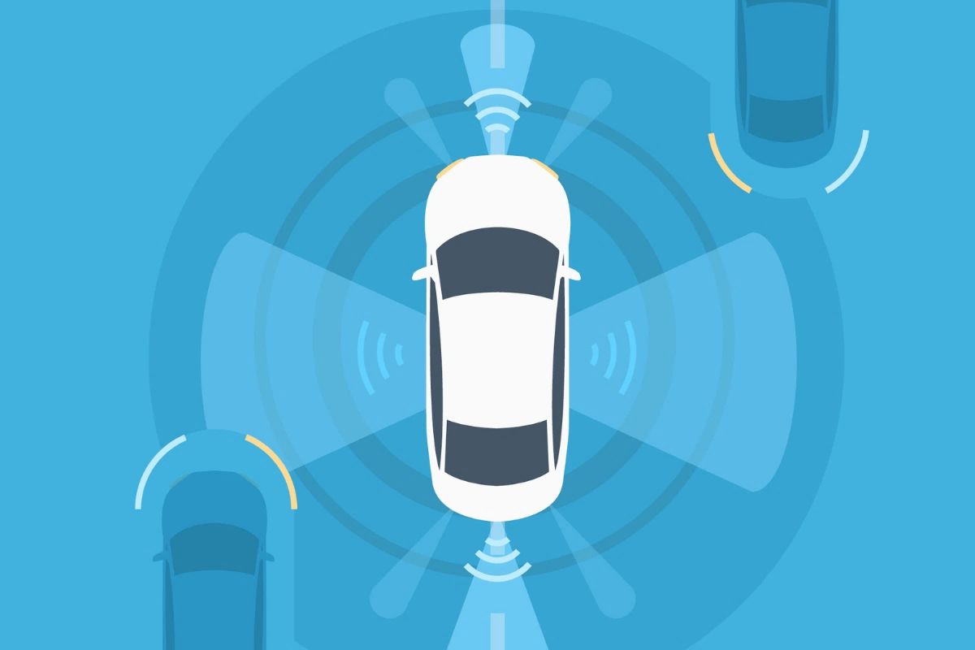
CAR Safety System
A perfect solution to ensure safety during driving

Slide 2

Team Members
01
02
03
04
Samina Mahjabeen
S.M. Tasnimul Hasan
180204129
180204142
MD Shohanur Rahman
MD Zahidul Haque
180204127
180204136

Slide 3
Objectives
01
02
03
Make things more Automated
To reduce the concequences of Car accidents
Benifacial for UBER car Owners
Driver will be able to control cars feature at finger tips
Many people die or get disabled for life because of Accidents
UBER car owners will be able to keep track of their cars health more effectively

Slide 4
Social Values
01
02
03
Economical
Reducing Accidents
A safe society
The solution will be affordable for every car
This automated safety system will hopefully reduce trrafic accidents
We hope to achive a safe environment for passengers, drivers and passer by

Slide 5
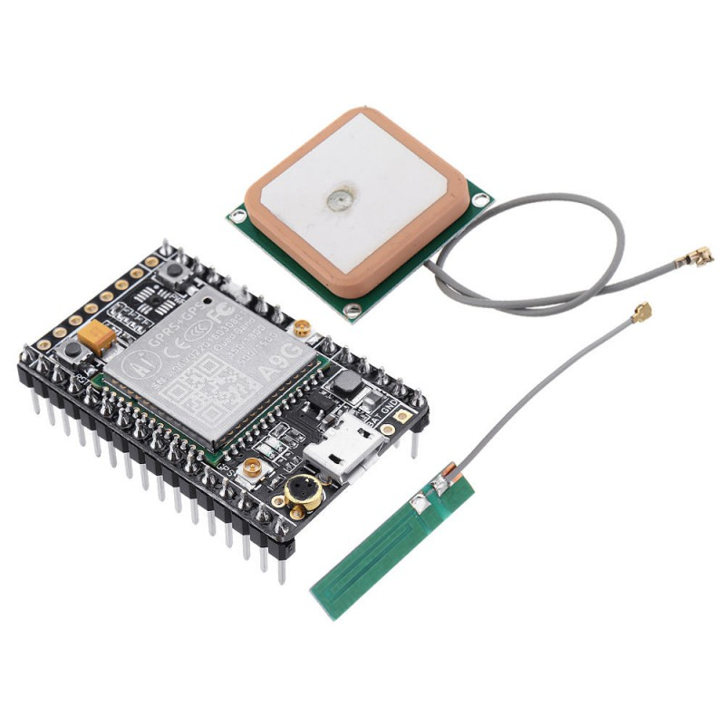
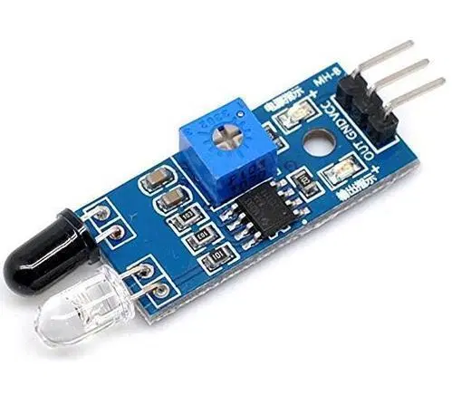
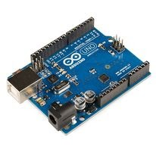
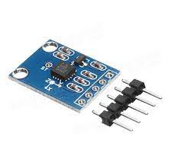
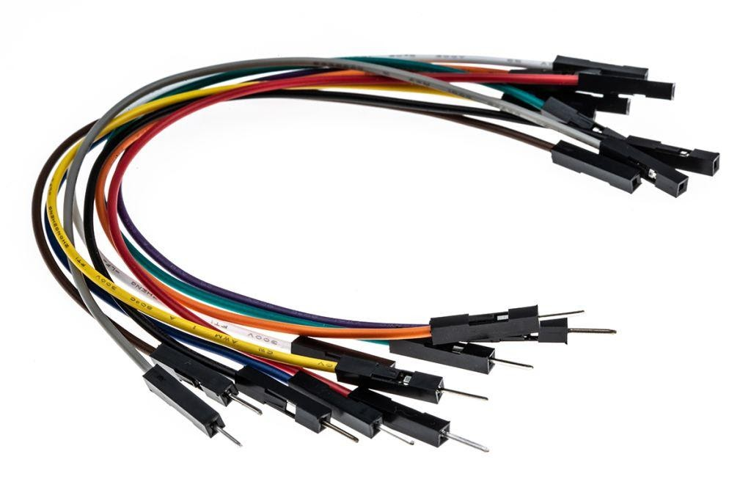
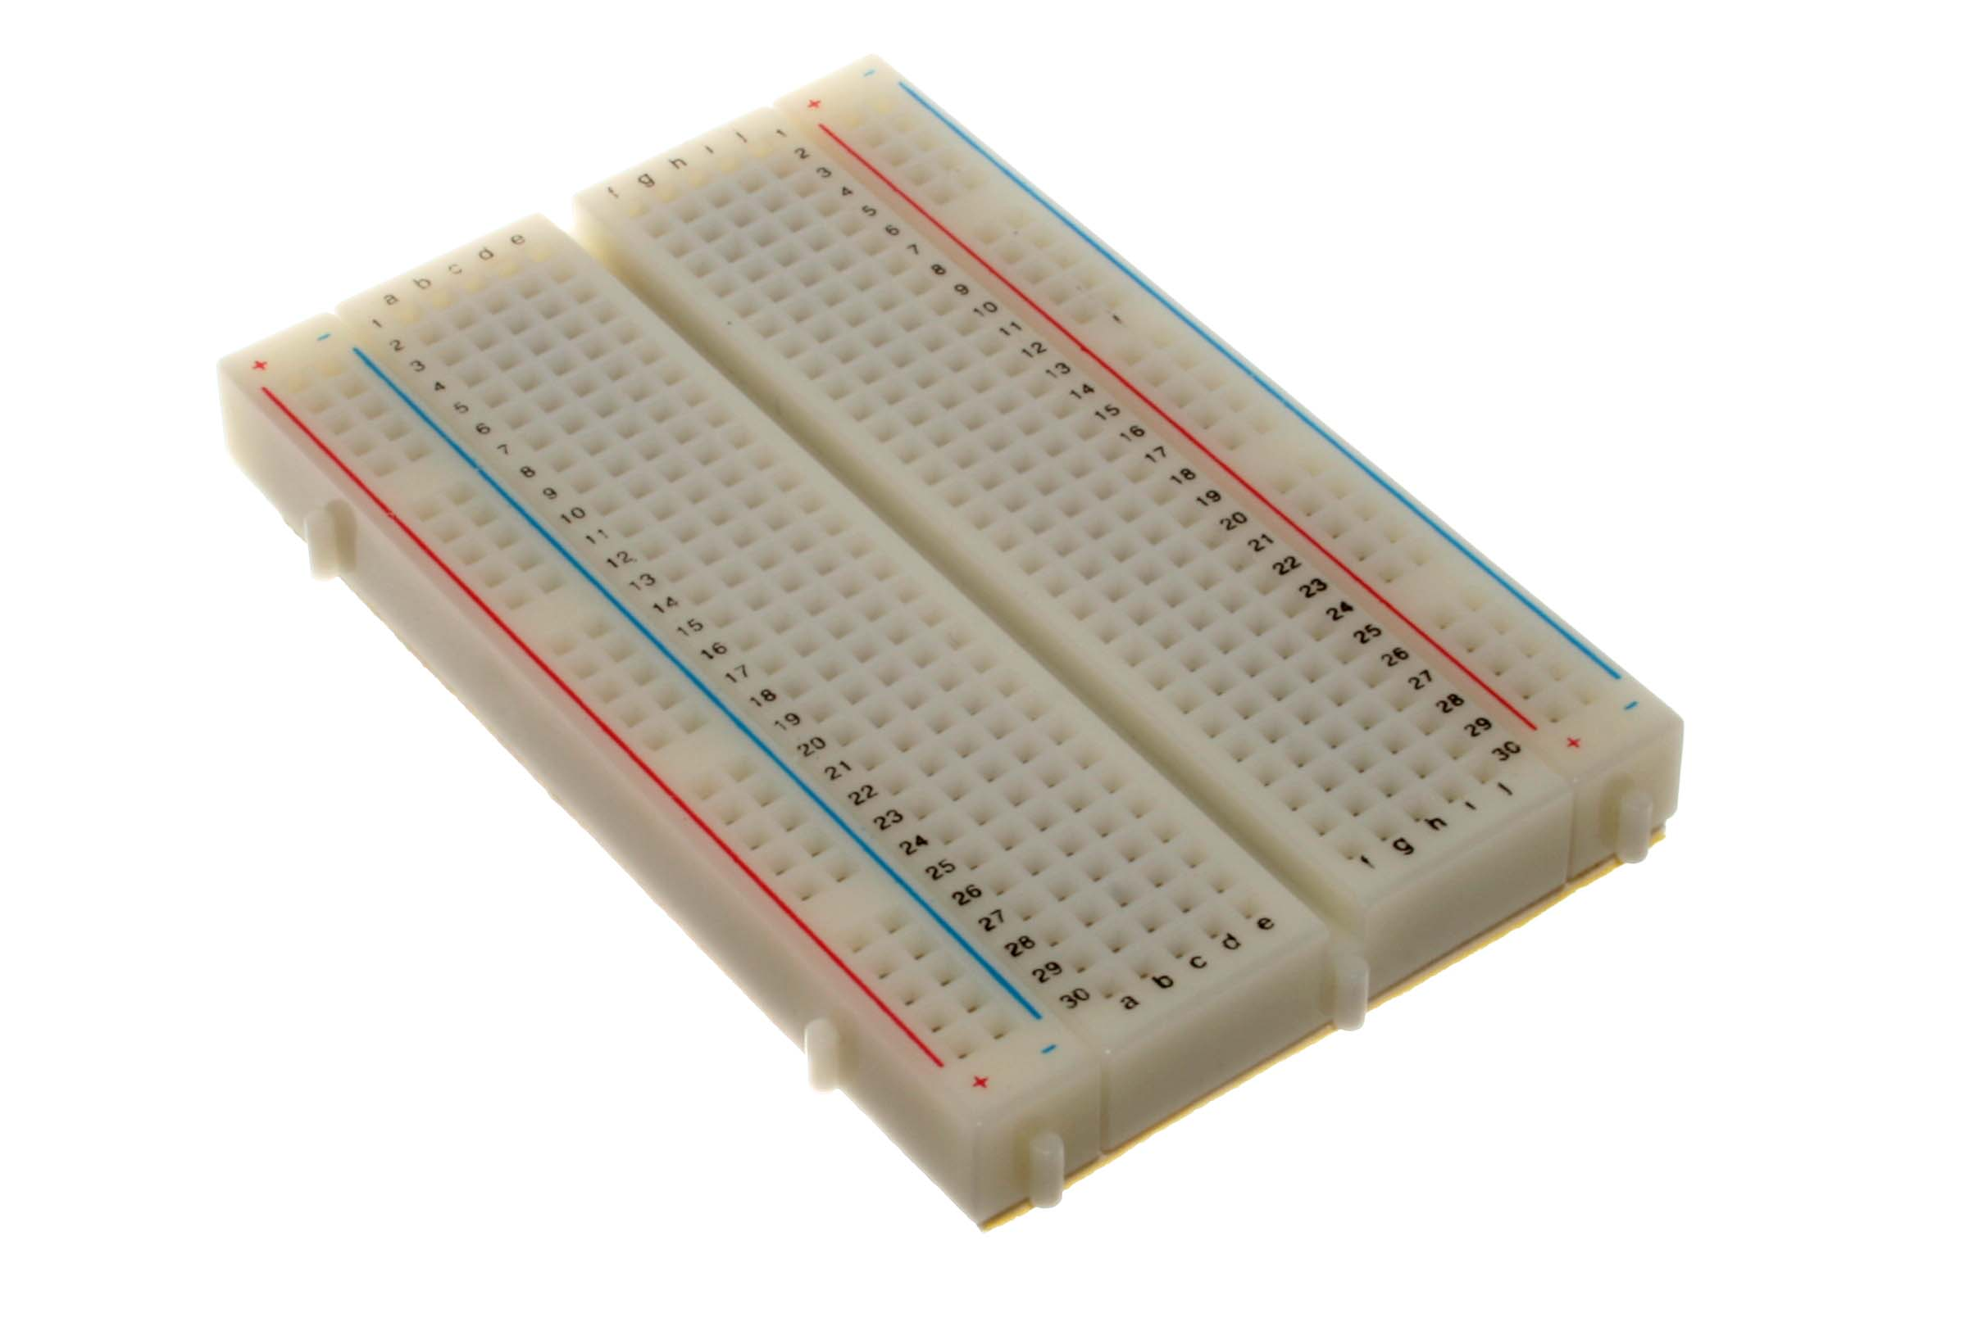
Recquired Components
IR sensor
A9G gps gsm Module
Auduino UNO
MPU 6050 6-DOF Sensor
BreadBoard
Connecting Wires

Slide 6
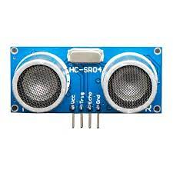
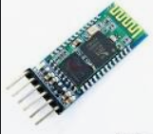
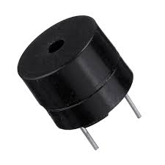
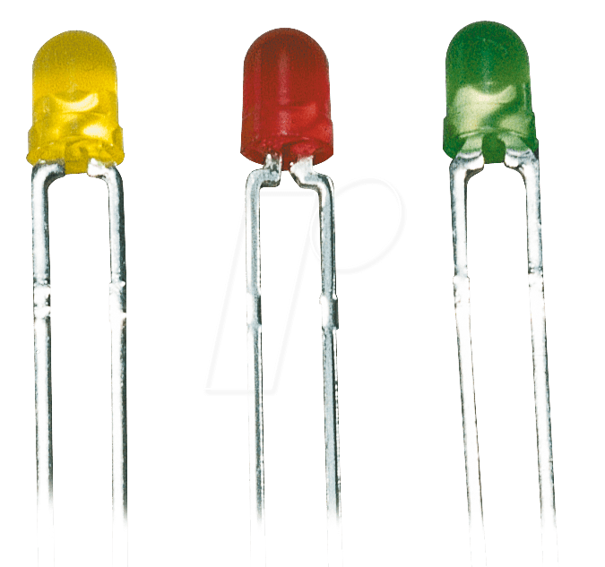
Recquired Components
Ultrasonic Sensor
Bluetooth Module
Buzzer
LED lights

Slide 7
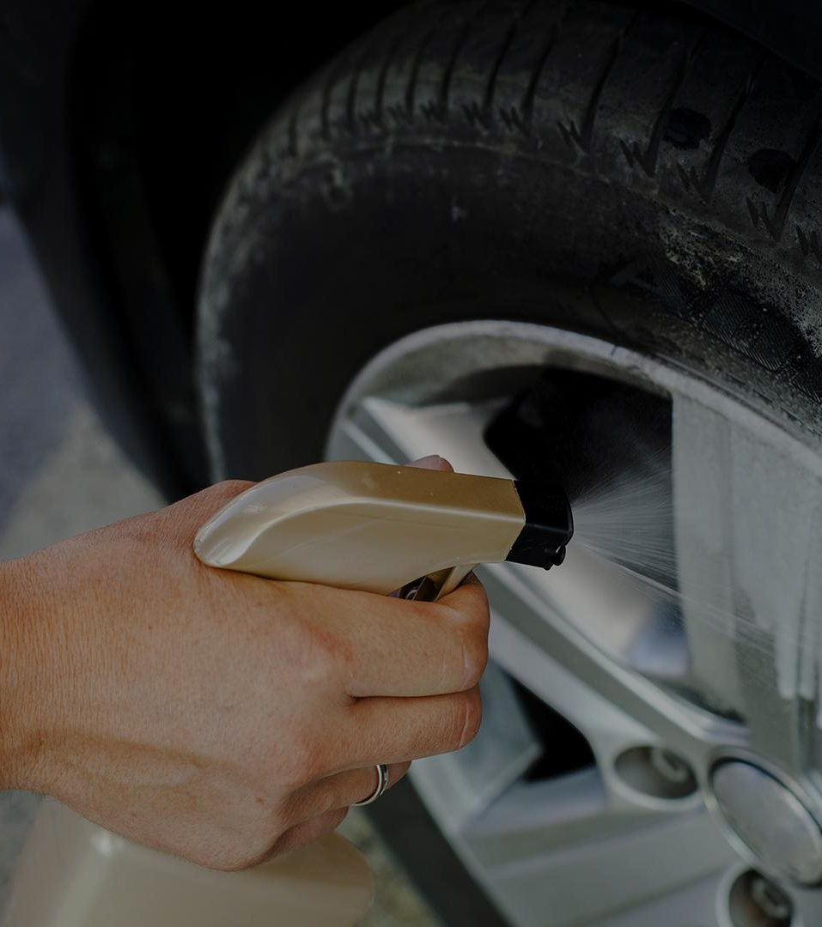
Working Procedure

Slide 8
PROBLEM VS. SOLUTION
PROBLEM
SOLUTION
The Uber car owners can keep track of their car’s current location but they don’t know if their car has ran into an accident
Our MPU-6050 gyro sensor will detect if the car has ran into an accident & then A9G GPS GSM Module send information to cars owner.

Slide 9
Problem
Solution
Many driver stays busy with phone or other work and they do not notice sudden obstacles
Our ultrasonic sensor will detect sudden obstacles and alarm the driver through Buzzer & LED

Slide 10
Moreover
Engine Thermal Control
Automated collision alert
Our MPU-6050 will detect will detect the temperature of the engine and alarm the driver if temp goes above certain level.
If a car comes too close from behind then our IR sensor will detect that car alert it through backlight.

Slide 11
Estimated Budget
Equipment | Quantity | Budget (Tk)
Arduino Mega 2560 R3 | 1 | 1450
SIM9001 GSM GPRS | 1 | 700
NEO-6M GPS | 1 | 450
Accelerometer ADXL335 | 1 | 390
Vero Board (Dotted) | 1 | 25
HX711AD Weight Sensor | 1 | 140
12V 300RPM DC Motor | 2 | 520
Buzzer | 1 | 15
HC-05 Bluetooth Module | 1 | 275
Connecting Wire | As required | 100
8 Volt Battery | 2 | 110
Ultrasonic Sensor | 1 | 100
Total |  | 4275

Slide 12
Actual Cost
Equipment | Quantity | Budget (Tk)
Arduino UNO R3 | 1 | 650
Bread Board | 3 | 190
LDR Module | 1 | 45
GY-521 Module | 1 | 160
HHC 05 Bluetooth Module | 1 | 250
IR Module | 1 | 35
10K Potentiometer | 2 | 20
HC SR04 Ultrasonic Sensor | 1 | 65
NPN Transistor | 5 | 10
Connecting Wire , Buzzer & LEDs | 4 set, 1, 6 | 216
AI thinker A9G GSM/GPRS Module | 1 | 1500
USB to TTL Converter | 2 | 220
9 Volt battery | 1 | 90
Total |  | 3451

Slide 13
Budget Comparison
Difference of cost = (Estimated Budget – Actual Cost)
= BDT (4275-3451)
= BDT 824
The main cost differentiator was the Arduino UNO instead of the Arduino MEGA.

Slide 14

Contribution of Team Members

Slide 15

Challenges
Collecting Proper Components
Bugs and Fixes
Connecting things properly

Slide 16
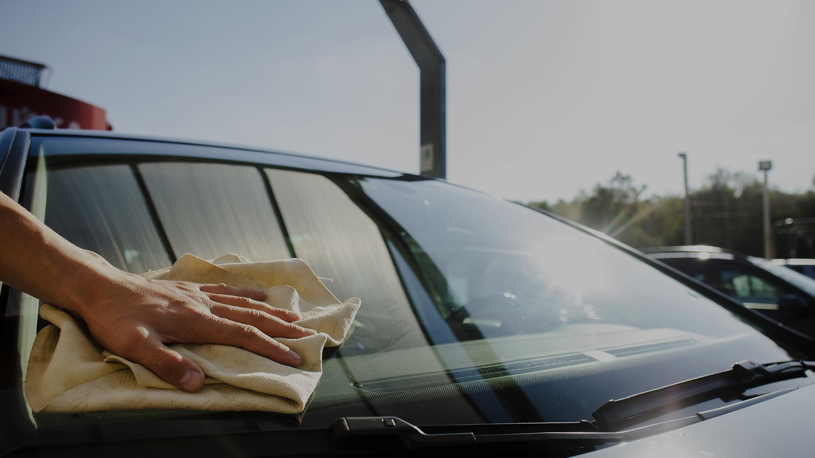
Conclusion
Road accidents are increasing day by day in recent times. Our system will reduce the occurrence of car accidents and its consequences.
We hope to make Bangladesh a safer place

Slide 17
Any Question
Thank You

